Slide 1
February 2019
R Programming Language
Sivakumar Ganesan

Slide 2
Day1: Introduction to R

Slide 3
Objectives
By the end of this session, you will be able to:
Define R.
Describe the R GUI interface.
Describe the R Studio interface.
Identify a working directory and modify it.
Recognize the basic commands related to packages.
Explain how to get help in R
Basic Data Types

Slide 4
What is R?
R is a programming language and software environment for statistical computing and graphics
It is a free, open source package based on the S language developed by Bell Labs.
Widely used among statisticians and data miners for developing statistical software and data analysis
A massive set of packages for statistical computing, machine learning, visualization, and importing and manipulating data.
R is an interpreted language
Expressions written into R console, interpreter program within R system, executes the actual code
Notes:
Ties different components of security through anomaly detection & behavioral analysis.
A converged platform for security technologies for anomaly detection that prevents enterprise risk.

Slide 5
What is R?
You can enter commands one at a time at the command prompt (>) or run a set of commands from a source file.
Unlike C, C++ or Java, no need to compile your programs into an object
Base R can be downloaded from CRAN. It contains base packages which required to run R and most fundamental functions
Few Applications :
Biostatistics - Medical data
Machine Learning, Deep Learning, Natural Language Processing, Image Processing, Business Analytics
Signal Processing – Electrical signal
Econometrics – Economic data
Statistical process control – Industrial process
Notes:
Ties different components of security through anomaly detection & behavioral analysis.
A converged platform for security technologies for anomaly detection that prevents enterprise risk.

Slide 6
Why is R?
It’s free, open source and runs on major platforms( even PS3, Arduino and Raspberry Pi)
One of the strengths of R is that the system can easily be extended. Massive set of open source packages; fantastic user community
Cutting edge tools. Immediate access to the very latest statistical techniques and implementations
Powerful tools for communicating your results; R packages produce html, pdf reports and create interactive dashboards
Designed to connect to high-performance programming languages like C, Fortran, C++, Python and Java.
Interfacing with big data (Spark and Hive) to handle large datasets

Slide 7
Drawbacks of R
Almost 40 years old technology
R’s biggest challenge most R users are not programmers; lack of knowledge in software engineering, best practices, source code control and automation testing
Much of the R packages written in hurry to solve complex problems; As a result code is not very elegant, fast or easy to understand
R is not a fast programming language; R is single threaded; Objects must be stored in physical memory

Slide 8
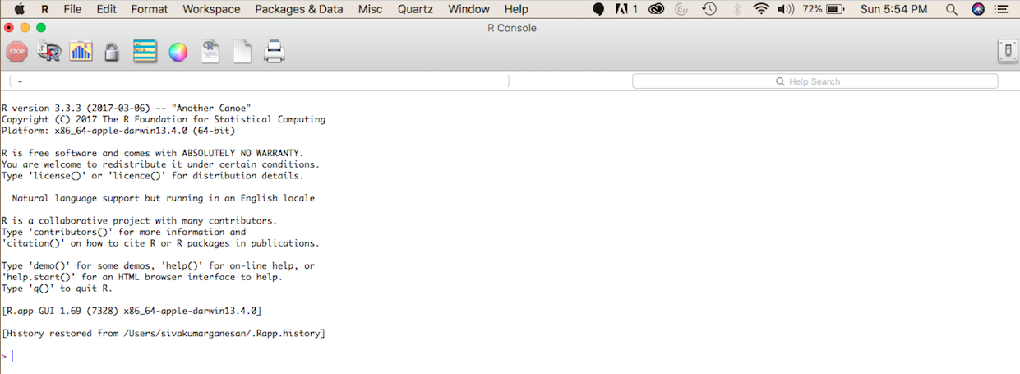
R GUI
Your first steps in R!!

Slide 9
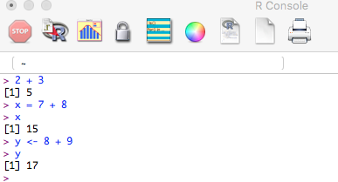
R GUI
Results of calculations can be stored in objects using the assignment operators:
An arrow (<-) formed by a smaller than character and a hyphen without a space!
The equal character (=).
Notes:
Ties different components of security through anomaly detection & behavioral analysis.
A converged platform for security technologies for anomaly detection that prevents enterprise risk.

Slide 10
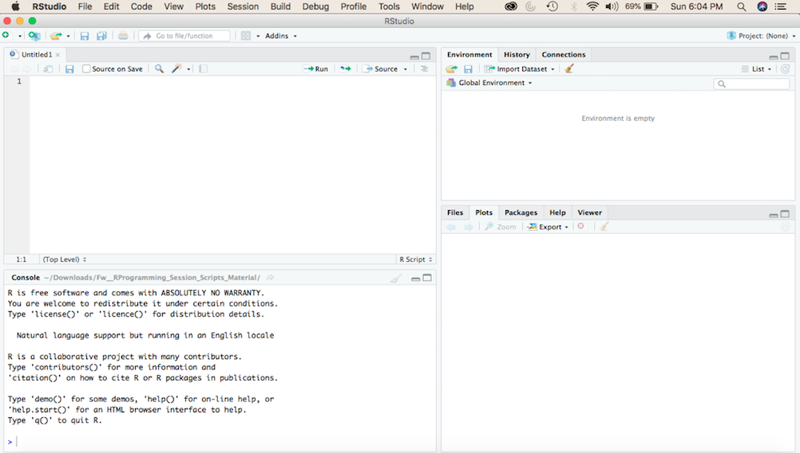
RStudio
R Studio is a free integrated development environment for R
It provides some convenient features and tools to work with R
It is merely a front end for R, it still needs to have R running in the background
Environment
History
Connections
Script Editor
Files
Plots
Packages
Help
Viewer
R Console

Slide 11
R Objects
All types of data are treated as objects. These objects can be used in other calculations. To print the object just enter the name of the object. There are some restrictions when giving an object a name:
A dot (.) and an underscore (_) are allowed, also a name starting with a dot.
Object names can contain a number but cannot start with a number.
Object names cannot contain symbols like !, +, -, #.
R is case sensitive, X and x are two different objects
Coding Standard: https://google.github.io/styleguide/Rguide.xml (copy to browser)
Notes:
Ties different components of security through anomaly detection & behavioral analysis.
A converged platform for security technologies for anomaly detection that prevents enterprise risk.

Slide 12
R Packages
The fundamental unit of shareable code is the Package (or Library).
A package bundles together code, data, documentation, and tests, and is easy to share with others
As of Feb 2019, there are over 13700 packages available in CRAN and 1600+ in Bioconductor(Open Source Software for Bioinformatics)
R comes with a standard set of packages. Others are available for download and installation.
install.packages() # install package
Once installed, packages have to be loaded into the session for usage.
library () # attach library to system
search () # packages loaded to the system
Notes:
Ties different components of security through anomaly detection & behavioral analysis.
A converged platform for security technologies for anomaly detection that prevents enterprise risk.

Slide 13
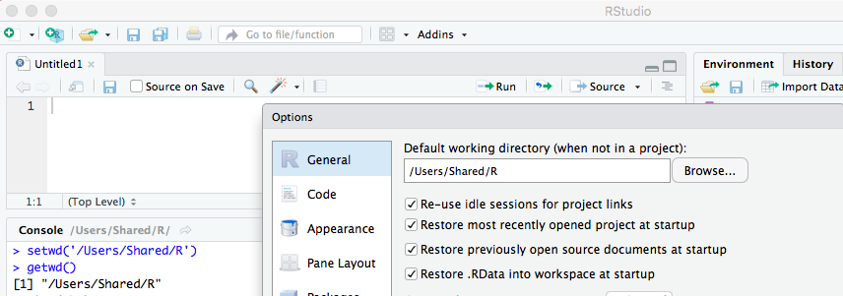
Setting working directory
Set working directory where datasets available or project folder:
Tools -> Global Options -> General or setwd()

Slide 14
References
CRAN, The Comprehensive R Archive Network, is the first place to go for almost anything to do with R (http://cran.r-project.org/)
References:
Quick-R
R Manuals
Cookbook for R ​
Resources:
r-bloggers
R-help mailing list
StackOverflow
stats.stackexchange
Github
Local R user group
Details about a specific command whose name you know (input arguments, options, algorithm, results):
>?t.test
or
>help(t.test)
or
>help.search('linear models')
or
>help.start()

Slide 15
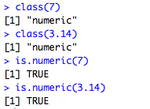
Basic Data Types
R Supports a few basic data types (also known as Atomic Vector types):
Integer, Numeric, Complex, Logical, Character/String.
Numeric:
class() to reveal data type
Impossible values are denoted by NaN; Numeric divided by zero denoted by Inf

Slide 16
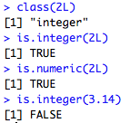

Basic Data Types
Integer: Denoted by L
Integer is numeric
Numeric is always not integer
Complex: Defined by including imaginary number, or i

Slide 17
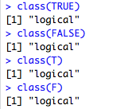
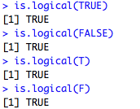

Basic Data Types
Logical:
Character:

Slide 18
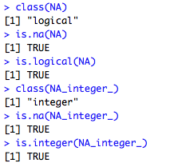
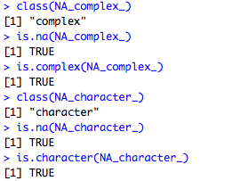
Missing Value
Missing values are represented by NA

Slide 19
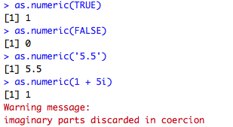
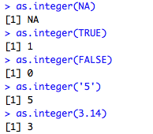
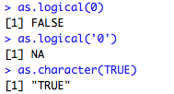
Coercion
Transform data types using coercion functions
When nonsensical coercion takes place, you will usually get a warning!

Slide 20
What have we learnt?
Basics of R
R Interface
Using R for the first time
Installing and using Packages
Reusing results
Basic Data Type

Slide 21
Day 2: Data Structures

Slide 22
Outline
Data Structures
Vectors
Lists
Matrices and Arrays
Factors
Dataframes
Notes:
Ties different components of security through anomaly detection & behavioral analysis.
A converged platform for security technologies for anomaly detection that prevents enterprise risk.

Slide 23
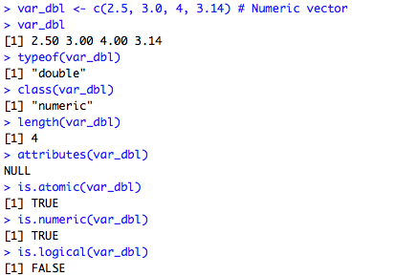
Data Structures
The basic data structure in R is vector. Vectors comes in two flavours: Vectors and Lists
Atomic vectors usually created with c(), for short for combine
Vectors are 1D and homogenous
Vectors differ in the data types; all elements of an atomic vector must be the same type.
Notes:
Ties different components of security through anomaly detection & behavioral analysis.
A converged platform for security technologies for anomaly detection that prevents enterprise risk.

Slide 24
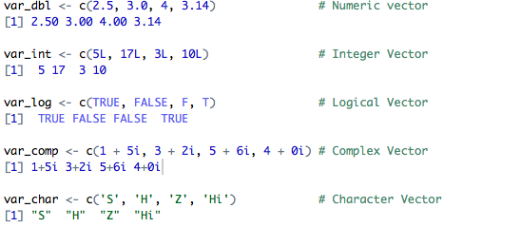
Vector
Types of Vectors : Numeric, Integer, Complex, Logical and Character
Atomic vectors are always flat; even if you nest
Missing values are specified by NA, which is logical vector of length 1
Notes:
Ties different components of security through anomaly detection & behavioral analysis.
A converged platform for security technologies for anomaly detection that prevents enterprise risk.

Slide 25
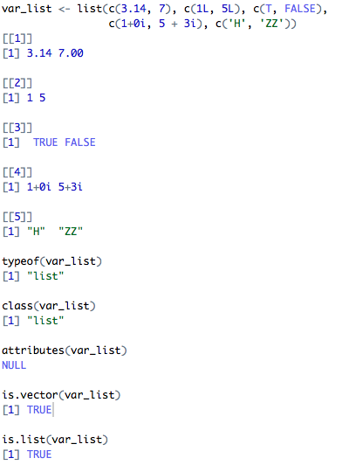
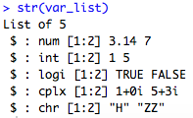
List
List is a collection of data of different data types
List is created by using list() instead of c()
List are sometime called as recursive vectors – list can contain other lists
List is 1D and heterogeneous
List can store other data structures – Array, Matrix and dataframes
Notes:
Ties different components of security through anomaly detection & behavioral analysis.
A converged platform for security technologies for anomaly detection that prevents enterprise risk.

Slide 26
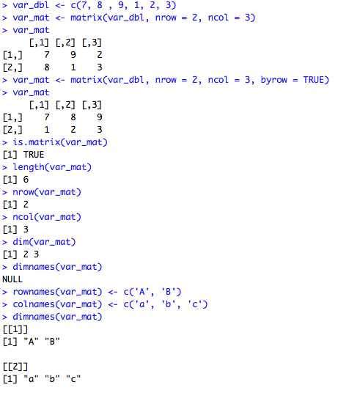
Matrices
Adding dim() attribute to an atomic vector behaves like Matrix
Matrices are created with matrix() or by using the assignment form of dim()
Matrices are 2D and homogenous
All elements of a matrix must be the same data type.
Matrices are used commonly as part of the mathematical machinery of statistics
Notes:
Ties different components of security through anomaly detection & behavioral analysis.
A converged platform for security technologies for anomaly detection that prevents enterprise risk.

Slide 27
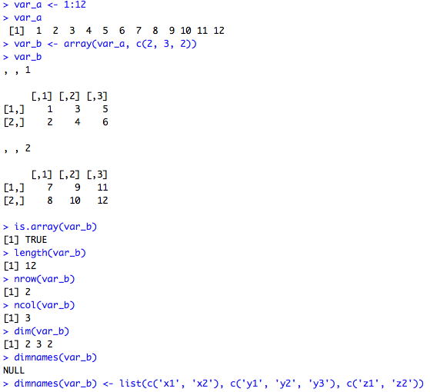
Arrays
Adding dim() attribute to an atomic vector behaves like Arrays
Arrays are created with array() or by using the assignment form of dim()
Matrices are nD and homogenous
All elements of a array must be the same data type.
Arrays are much rarer, but worth being aware of.
Notes:
Ties different components of security through anomaly detection & behavioral analysis.
A converged platform for security technologies for anomaly detection that prevents enterprise risk.

Slide 28
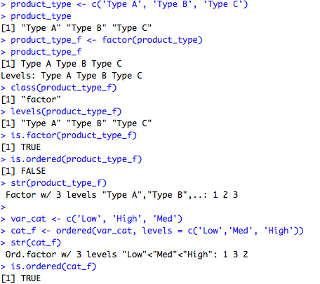
Factors
Factor is a special type of vectors
Used to store categorical data
Factors are built on top of integer vectors using two attributes
Class : factor differentiates from integer vectors
Levels: defines set of allowed values
Factors could be ordered or unordered
Factors are treated by statistical modeling functions like lm() or glm()
Notes:
Ties different components of security through anomaly detection & behavioral analysis.
A converged platform for security technologies for anomaly detection that prevents enterprise risk.

Slide 29
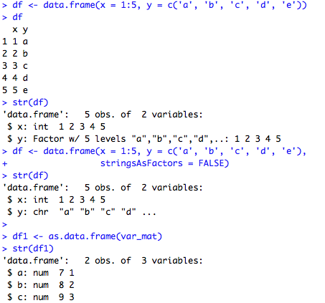
Dataframes
Dataframe is the most common way of storing data in R
Under the hood, a data frame is a list of equal-length vectors
Unlike Matrices or array, dataframe can store any data types
Dataframes are 2D and heterogeneous
Matrix can be created by:
data.frame()
as.data.frame()
read.csv()
read.table()
Special attribute row.names()
Notes:
Ties different components of security through anomaly detection & behavioral analysis.
A converged platform for security technologies for anomaly detection that prevents enterprise risk.

Slide 30
Dataframes
Dataframe is the most common way of storing data in R
Under the hood, a data frame is a list of equal-length vectors
Unlike Matrices or array, dataframe can store any data types
Dataframes are 2D and heterogeneous
Matrix can be created by:
data.frame()
as.data.frame()
read.csv()
read.table()
Special attribute row.names()
Notes:
Ties different components of security through anomaly detection & behavioral analysis.
A converged platform for security technologies for anomaly detection that prevents enterprise risk.

Slide 31
Day 3:
Data Import and Transformation

Slide 32
Objectives
By the end of this session, you will be able to:
Read data from text, csv and excel sheets
Read data from other statistical tools (SAS, SPSS)
Read data from database
Basic and advanced data transformations

Slide 33
Reading Data
From a file :
base package:
readLines() : reads lines from text file
utils package:
read.table() : reads delimited data from text file
read.csv() : reads csv data from file
read.delim() : reads tab delimited data from text file
readr package
read_delim() : reads delimited data from text file
read_csv() : reads csv data from file
read_tsv : reads tab delimited data from text file
fread package
data.table() : reads delimited data from text file
Notes:
Ties different components of security through anomaly detection & behavioral analysis.
A converged platform for security technologies for anomaly detection that prevents enterprise risk.

Slide 34
Reading Data
From Excel sheet:
{readxl} | excel_sheets() | to read all sheets in xls or xlsx file
 | path | path of the source file
 | read_excel() | xls to csv(using perl) and read csv data using read.csv(read.table) wrapper function
 | path | path of the source file
 | sheet | sheet name or number of the sheet to be imported
 | col_names | TRUE by default
 |  | FALSE; R assign name itself
 |  | character vector; manually specify
 | col_types | NULL by default
 |  | specify the data type with vector - text, numeric, date, (blank - to ignore the field)
 | skip | to skip the rows from the top
{gdata} | read.xls()
 | xls | path of the source file
 | sheet | sheet name or number of the sheet to be imported
{XLConnect} | loadWorkbook() | build a bridge between excel sheet and R session; creates workbook class
 | filename | path to the source file
 | getSheets() | to read all sheet names in xls or xlsx
 | object | name of the workbook object
 | readWorksheet() | to read data from a sheet
 | object | name of the workbook object
 | sheet | name or index of the sheet to be imported
 | startCol | index of the column to read from
 | endCol | index of the last column to read from
 | startRow | index of the row to read from
 | endRow | index of the last row to read from
Notes:
Ties different components of security through anomaly detection & behavioral analysis.
A converged platform for security technologies for anomaly detection that prevents enterprise risk.

Slide 35
Reading Data
MySQL Database:
{RMySQL} | dbconnect() | create connection to MySQL database; returns "MySQLConnection" object
 | RMySQL::MySQL() | driver to connect MySQL DB
 | dbname | database name
 | host | host name
 | port | port #
 | user | user name
 | password | password
 | dbListTables() | returns list of tables from remote database
 | conn | connection object
 | dbReadTable() | import database table as data.frame
 | conn | connection name
 | name | table name
 | dbGetQuery() | import query results as data.frame
 | conn | connection name
 | statement | source query
 | dbSendQuery() | submit the query to database and returns result object "MySQLResult"
 | conn | connection name
 | statement | source query
 | dbFetch() | Fetch the results from dbsendQuery()
 | res | Result object
 | n | number of rows to be fetched for each call
 | dbClearResult()
 | res | free all resources associated with result object
 | dbDisconnect() | disconnections db session
Notes:
Ties different components of security through anomaly detection & behavioral analysis.
A converged platform for security technologies for anomaly detection that prevents enterprise risk.

Slide 36
Reading Data
From other statistical Tools
{haven} | read_sas() | converts SAS file(sas7bdat) into R objects(tbl, tbl_df and data.frame)
 | data_file | file location
 | read_dta() | convert STATA DTA file into R objects
 | file | path to a file, a connection or source url
 | read_sav() | convert SPSS .sav file into R objects
 | file | path to a file, a connection or source url
 | read_por() | convert SPSS .por file into R objects
 | file | path to a file, a connection or source url
{foreign} | read.dta() | convert STATA DTA file into R objects
 | file | path to a file, a connection or source url
 | convert.dates | TRUE by default, converts STATA date to date class; STATE date-time to POSIXct
 | convert.factors | TRUE by default, converts STATA value labels to factors
 | missing.type | FALSE by default; convert STATA missing values to NA
 | convert.underscore | FALSE by default; convert "_" in STATA variables to "." in R variable names
 | read.spss() | convert SPSS file into R objects
 | file | path to a file, a connection or source url
 | use.value.labels | TRUE by default, converts SPSS value labels to factors
 | to.data.frame | FALSE by default, convert SPSS data into R data.frame
Notes:
Ties different components of security through anomaly detection & behavioral analysis.
A converged platform for security technologies for anomaly detection that prevents enterprise risk.

Slide 37
Downloading Data
file.path : constructs path to directory
dir.exists : returns TRUE when the folder is present
dir.create : creates directory
download.file() : downloads files from web
url : web address of source file
destfile : destination location where data file to be stored
method : "auto" by default; set "curl" if url is https on mac
Every R object can be stored into and restored from a file with the commands “save” and “load”.
> save(df, file=“df.Rdata”)
> load(“df.Rdata”)
Notes:
Ties different components of security through anomaly detection & behavioral analysis.
A converged platform for security technologies for anomaly detection that prevents enterprise risk.

Slide 38
Data Transformation
Once you have access to your data, you will need to transform to useful form. This includes creating new variables (including recoding and renaming existing variables), sorting and merging datasets, aggregating data, reshaping data, and subsetting datasets (including selecting observations that meet criteria, randomly sampling observation, and dropping or keeping variables).
Each of these activities usually involve the use of R's built-in operators (arithmetic and logical) and functions (numeric, character, and statistical). Additionally, you may need to use control structures (if-then, for, while, switch) in your programs and/or create your own functions. Finally you may need to convert variables or datasets from one type to another (e.g. numeric to character or matrix to data frame).
Notes:
Ties different components of security through anomaly detection & behavioral analysis.
A converged platform for security technologies for anomaly detection that prevents enterprise risk.

Slide 39
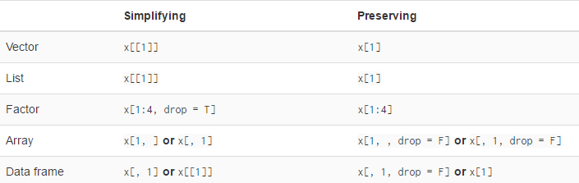
Subsetting
Individual elements of a vector, matrix, array or data frame are accessed with “[ ]” by specifying their index, or their name
Notes:
Ties different components of security through anomaly detection & behavioral analysis.
A converged platform for security technologies for anomaly detection that prevents enterprise risk.

Slide 40
Creating New Variables
Use the assignment operator <- to create new variables. A wide array of operators and functions are available here.
Three examples for doing the same computations mydata$sum <- mydata$x1 + mydata$x2 mydata$mean <- (mydata$x1 + mydata$x2)/2 attach(mydata) mydata$sum <- x1 + x2 mydata$mean <- (x1 + x2)/2 detach(mydata)
mydata <- transform(mydata, sum = x1 + x2, mean = (x1 + x2)/2 )
Notes:
Ties different components of security through anomaly detection & behavioral analysis.
A converged platform for security technologies for anomaly detection that prevents enterprise risk.

Slide 41
Creating New Variables
Recoding variables : In order to recode data, you will probably use one or more of R's control structures.
# create 2 age categories mydata$agecat <- ifelse(mydata$age > 70, c("older"), c("younger"))
# another example: create 3 age categories attach(mydata) mydata$agecat[age > 75] <- "Elder" mydata$agecat[age > 45 & age <= 75] <- "Middle Aged" mydata$agecat[age <= 45] <- "Young" detach(mydata)
Notes:
Ties different components of security through anomaly detection & behavioral analysis.
A converged platform for security technologies for anomaly detection that prevents enterprise risk.

Slide 42
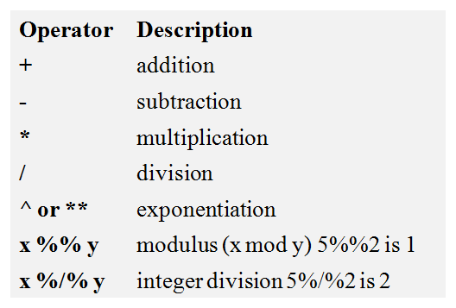
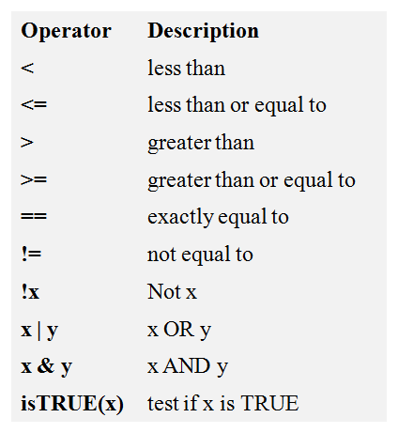
Operators
Arithmetic Operators Logical Operators
Notes:
Ties different components of security through anomaly detection & behavioral analysis.
A converged platform for security technologies for anomaly detection that prevents enterprise risk.

Slide 43
Sorting
To sort a dataframe in R, use the order( ) function. By default, sorting is ASCENDING. Prepend the sorting variable by a minus sign to indicate DESCENDING order. Few Examples:
# sorting examples using the mtcars dataset data(mtcars)
# sort by mpg newdata = mtcars[order(mtcars$mpg),]
# sort by mpg and cyl newdata <- mtcars[order(mtcars$mpg, mtcars$cyl),]
#sort by mpg (ascending) and cyl (descending) newdata <- mtcars[order(mtcars$mpg, -mtcars$cyl),]
Notes:
Ties different components of security through anomaly detection & behavioral analysis.
A converged platform for security technologies for anomaly detection that prevents enterprise risk.

Slide 44
Merging
To merge two dataframes (datasets) horizontally, use the merge function.
In most cases, you join two dataframes by one or more common key variables (i.e., an inner join).
# merge two dataframes by ID total <- merge(dataframeA,dataframeB,by="ID")
# merge two dataframes by ID and Country total <- merge(dataframeA,dataframeB,by=c("ID","Country"))
Notes:
Ties different components of security through anomaly detection & behavioral analysis.
A converged platform for security technologies for anomaly detection that prevents enterprise risk.

Slide 45
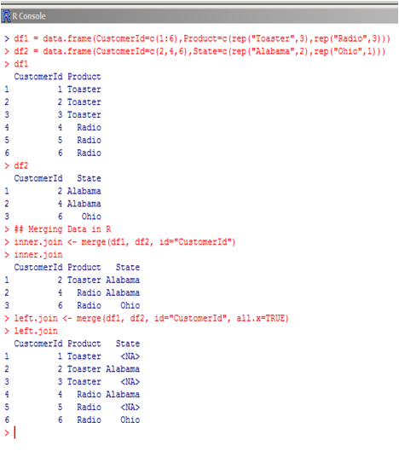
Merging
## Creating test Data frames to apply merge
df1 = data.frame(CustomerId=c(1:6),
Product=c(rep("Toaster",3),rep("Radio",3)))
df2 = data.frame(CustomerId=c(2,4,6),
State=c(rep("Alabama",2),rep("Ohio",1)))
## Merging Data in R
inner.join <- merge(df1, df2, id="CustomerId")
left.join <- merge(df1, df2, id="CustomerId", all.x=TRUE)
## Now Try
right.join <- merge(df1, df2, id="CustomerId", all.y=TRUE)
outer.join <- merge(df1, df2, id="CustomerId", all=TRUE)
Notes:
Ties different components of security through anomaly detection & behavioral analysis.
A converged platform for security technologies for anomaly detection that prevents enterprise risk.

Slide 46
Merging
ADDING ROWS
To join two dataframes (datasets) vertically, use the rbind function. The two dataframes must have the same variables, but they do not have to be in the same order.
total <- rbind(dataframeA, dataframeB)
If dataframeA has variables that dataframeB does not, then either:
Delete the extra variables in dataframeA or
Create the additional variables in dataframeB and set them to NA (missing)
before joining them with rbind.
Notes:
Ties different components of security through anomaly detection & behavioral analysis.
A converged platform for security technologies for anomaly detection that prevents enterprise risk.

Slide 47
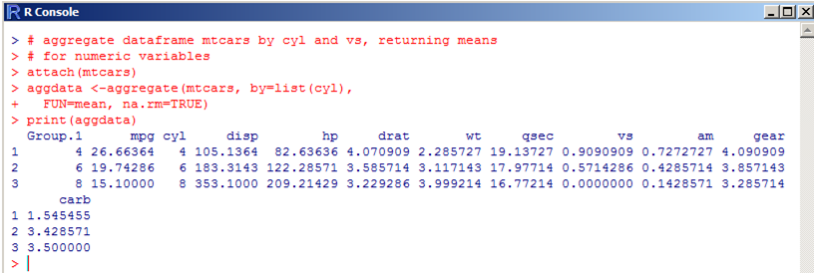
Aggregating
It is relatively easy to collapse data in R using one or more BY variables and a defined function.
# aggregate dataframe mtcars by cyl and vs, returning means # for numeric variables attach(mtcars) aggdata <-aggregate(mtcars, by=list(cyl), FUN=mean, na.rm=TRUE) print(aggdata)
Notes:
Ties different components of security through anomaly detection & behavioral analysis.
A converged platform for security technologies for anomaly detection that prevents enterprise risk.

Slide 48
Aggregating
When using the aggregate() function, the by variables must be in a list (even if there is only one). The function can be built-in or user provided.
See also:
summarize() in the Hmisc package
summaryBy() in the doBy package
Notes:
Ties different components of security through anomaly detection & behavioral analysis.
A converged platform for security technologies for anomaly detection that prevents enterprise risk.

Slide 49
Day 4: Control Structures in R

Slide 50
Control Structures
R has the standard control structures you would expect.
expressions can be multiple (compound) statements by enclosing them in braces { }.
It is more efficient to use built-in functions rather than control structures whenever possible.
If (cond) expr1 else expr2: Testing a condition
for (cond) expr3 : execute loop for fixed set of numbers
while(cond) expr4 : execute loop when condition is true
repeat expr5: executes infinite loop
break : breaks execution of loop
next : next iteration of the loop
return: exit function
Notes:
Ties different components of security through anomaly detection & behavioral analysis.
A converged platform for security technologies for anomaly detection that prevents enterprise risk.

Slide 51
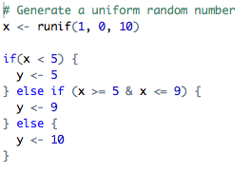
If else
The if-else combination is probably the most commonly used control structure in R
You can have a series of tests by following the initial if with any number of else if
If (condition1) {
# do something
} else if (condition2) {
# do something different
} else {
# do something different
}
Notes:
Ties different components of security through anomaly detection & behavioral analysis.
A converged platform for security technologies for anomaly detection that prevents enterprise risk.

Slide 52
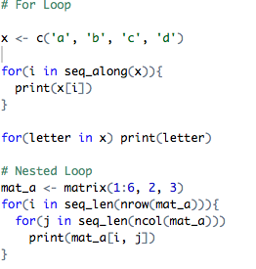
For Loop
For loops are most commonly used for iterating over the elements of an object (list, vector, etc.)
The seq_along() function is commonly used in conjunction with for loops in order to generate an integer sequence based on the length of an object
For one line loops, the curly braces are not strictly necessary.
for (iteration condition){
# do something
}
Notes:
Ties different components of security through anomaly detection & behavioral analysis.
A converged platform for security technologies for anomaly detection that prevents enterprise risk.

Slide 53
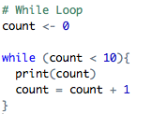
While Loop
While loops begin by testing a condition. If it is true, then they execute the loop body. Once the loop body is executed, the condition is tested again, and so forth, until the condition is false, after which the loop exits
While loops can potentially result in infinite loops if not written properly. Use with care!
While (condition){
# do something
}
Notes:
Ties different components of security through anomaly detection & behavioral analysis.
A converged platform for security technologies for anomaly detection that prevents enterprise risk.

Slide 54
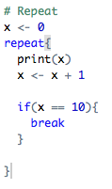
Repeat
Repeat initiates an infinite loop right from the start
The only way to exit a repeat loop is to call break
repeat{
# do something
if (condition){
break
}
}
Notes:
Ties different components of security through anomaly detection & behavioral analysis.
A converged platform for security technologies for anomaly detection that prevents enterprise risk.

Slide 55
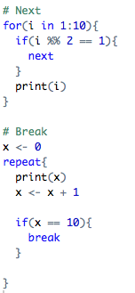
Next and Break
Next is used to skip an iteration of a loop
for (iteration condition){
# do something
if(condition) {
next
}
}
Break is used to exit a loop immediately
repeat{
# do something
if (condition){
break
}
}
Notes:
Ties different components of security through anomaly detection & behavioral analysis.
A converged platform for security technologies for anomaly detection that prevents enterprise risk.

Slide 56
Functions
Functions can be defined using the function() expression and are assigned to R objects just like any other R object
Functions have can be defined with named arguments; these function arguments can have default values
Functions arguments can be specified by name or by position in the argument list
f <- function(arg1, args2){
# do something
}
Notes:
Ties different components of security through anomaly detection & behavioral analysis.
A converged platform for security technologies for anomaly detection that prevents enterprise risk.

Slide 57

mapply()
mapply() applies function in parallel over set of arguments
Usage: mapply(FUN, ..., MoreArgs = NULL)
Arguments:
FUN: function to apply
… : objects to apply over
MoreArgs : list of other arguments to FUN
Notes:
Ties different components of security through anomaly detection & behavioral analysis.
A converged platform for security technologies for anomaly detection that prevents enterprise risk.

Slide 58
Visualization in R
Base graphics are usually constructed piecemeal, with each aspect of the plot handled separately through a series of function calls; this is often conceptually simpler and allows plotting to mirror the thought process
Lattice graphics are usually created in a single function call, so all of the graphics parameters have to specified at once; specifying everything at once allows R to automatically calculate the necessary spacing and font sizes.
ggplot2 combines concepts from both base and lattice graphics but uses an independent implementation
Notes:
Ties different components of security through anomaly detection & behavioral analysis.
A converged platform for security technologies for anomaly detection that prevents enterprise risk.

Slide 59
Thank You

